Slide 1
L2 (CHAPTER 5) Programming in Assembly Part 1: Computer Organization

Slide 2
von Neumann Architecture
Memory holds data, instructions.
CPU fetches instructions from memory.
CPU registers: program counter (PC), instruction register (IR), general-purpose registers, etc.
Notes:
Separate CPU and memory distinguishes programmable computer.

Slide 3
CPU + Memory
memory
address
CPU
PC
200
data
ADD r5,r1,r3
ADD r5,r1,r3
200
IR

Slide 4
Harvard Architecture
address
CPU
data memory
data
PC
address
program memory
data

Slide 5
von Neumann vs. Harvard
Harvard allows two simultaneous memory fetches.
Most DSPs use Harvard architecture for streaming data:
greater memory bandwidth;
more predictable bandwidth.
Harvard can’t use self-modifying code.
Instruction memory is read-only

Slide 6
A Typical Desktop Processor (von Neumann Arch. as example)
Three major components:
(1) CPU , where operations are performed,
(2) memory , where data is stored, and
(3) input/output (I/O) system, to gather input data or to output results.
The three units are interconnected by groups of wires called buses.
Data transferred between memory and I/O devices normally goes through and is coordinated by the CPU. Direct Memory Access (DMA) controller can be added to perform these transfers without involving the CPU
Memory Data Transfers
CPU
(Arithmetic and Logic Unit, Control Logic, and Registers)
Memory
(Instructions and Data)
I/O
(Disk, keyboard, display, etc.)
DMA Controller
I/O Data Transfers

Slide 7
A Typical Embedded Processor (von Neumann Arch. as Example)
Memory-mapped I/O
A 32-bit memory address is capable of referencing 4 GB (2³² bytes) of information
A portion of the address space is reserved for and decoded by the I/O devices. This eliminates the need for separate I/O instructions since all of the regular instructions for accessing memory can then be used to access I/O devices.
DMA controller is often not present, since most embedded applications do not require very high data transfer rates
Memory and I/O Data Transfers
CPU
(Arithmetic and Logic Unit, Control Logic, and Registers)
Memory
(Instructions and Data)
I/O
(Disk, keyboard, display, etc.)
DMA Controller
Notes:
Memory-Mapped Peripherals

Slide 8
Memory
Information flows between the CPU and memory over three sets of wires called the address bus , the data bus , and the control bus.
The CPU places information on the address bus to tell the memory which data to access
uses the control bus to determine the direction of information transfer and to coordinate timing
The data itself is transferred over the data bus
Address bus has N wires, where N is # bits in each address (8,16,32,64…)
Data bus has 4x8 wires, hence each data transfer is 4 Bytes (also called 1 word)
Address Bus: N wires
Data Bus: 4x8 wires
2^{N} bytes
Organized into
groups of 4 bytes
Control Bus:
Read vs Write,
Initiate Cycle,
Data Ready
Content is 1’s and 0’s.

Slide 9
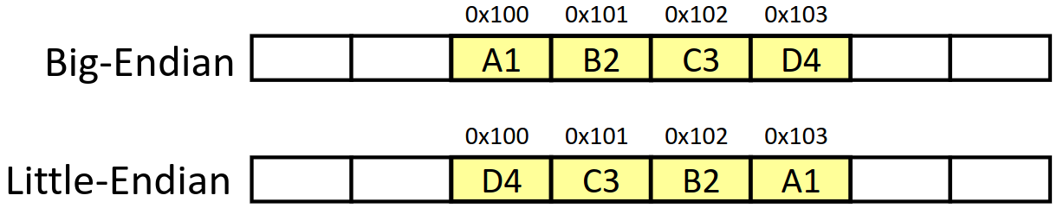
Memory Byte Ordering
Two possible byte orderings:
Little-endian: the LSB (Least Significant Byte) is stored at the lowest address.
Big-endian: the LSB (Least Significant Byte) is stored at the highest address.
Intel processors use Little-Endian; ARM processors can be configured as either Little- or Big-endian; STM32 microcontrollers based on ARM Cortex-M3 use little-endian
Example: 4-byte data 0xA1B2C3D4 at address 0x100
LSB
MSB
MSB
LSB
Notes:
Below are examples of Little Endian ordering (A 32-bit memory range can contain one 32-bit word, or two 16-bit half-words, or four 8-bit Bytes)

Slide 10
Quiz: Memory Byte Ordering
The word stored at address 0x20008000
with Big-Endian ordering is
Memory Address | Memory Data
0x20008003 | 0xA7
0x20008002 | 0x90
0x20008001 | 0x8C
0x20008000 | 0xEE
?
with Little-Endian ordering is
?
0xEE8C90A7
0xA7908CEE
0xEEC8097A
0x7A09C8EE

Slide 11
Quiz: Memory Byte Ordering ANS
The word stored at address 0x20008000
with Big-Endian ordering is
Memory Address | Memory Data
0x20008003 | 0xA7
0x20008002 | 0x90
0x20008001 | 0x8C
0x20008000 | 0xEE
A) 0xEE8C90A7
with Little-Endian ordering is
B) 0xA7908CEE
0xEE8C90A7
0xA7908CEE
0xEEC8097A
0x7A09C8EE
Endianness specifies Byte order, not bit order within a Byte

Slide 12
Data Alignment
Assume a byte-addressable memory with a data bus that is 32 bits (4 bytes) wide
Consider 16 bytes of memory (addresses 0 to 15) arranged as four 32-bit words (4 bytes each)
Well-aligned: each word begins on a mod-4 address, which can be read in a single memory cycle
Ill-aligned: a word begins on address 6, not a mod-4 address, which can be read in 2 memory cycles
The first read cycle would retrieve 4 bytes from addresses 4 through 7; of these, the bytes from addresses 4 and 5
are discarded, and those from addresses 6 and 7 are moved to the far right;
The second read cycle retrieves 4 bytes from addresses 8 through 11; the bytes from addresses 10 and 11 are discarded, and those from addresses 8 and 9 are moved to the far left;
Finally, the two halves are combined to form the desired 32-bit operand:

Slide 13
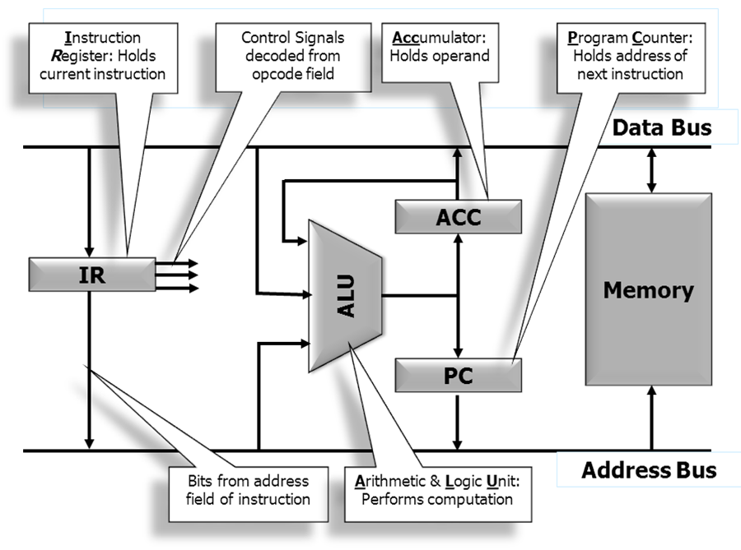
Single Accumulator Architecture
A CPU consists of several components, including the arithmetic and logic unit (ALU) , a set of registers, and a control unit . One or more data and address buses interconnect these components.
Instruction registers hold the current instruction; a program counter (PC) to specify the address of the next instruction to be executed, and others
Data registers hold the operands and the result. In the simplest configuration, a single data register called the accumulator (ACC) is used
Notes:
a status register to hold information about the most recent result produced
by the ALU.

Slide 14
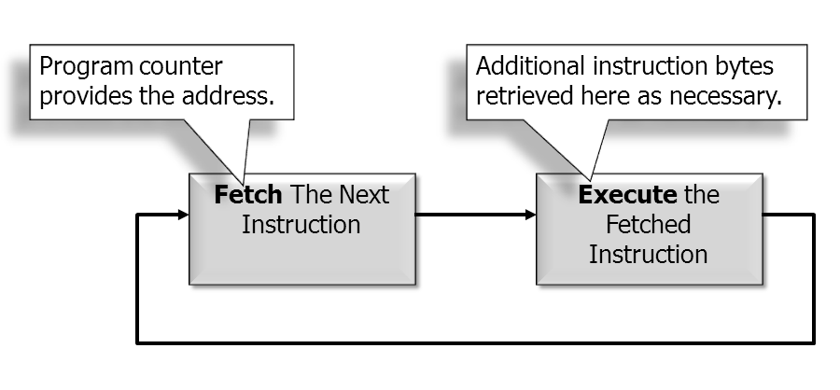
The Fetch-Execute Cycle
(There is typically an instruction decode stage that is omitted here for simplicity)

Slide 15
Instruction Fetch
1. Memory_Address_Bus ← Program_Counter
2. Start Memory Read Operation
3. Increment Program_Counter
4. Wait for Memory Read to Complete
5. Instruction_Register ← Memory_Data_Bus
6. Go to execute phase.
Data Bus
ACC
Memory
IR
ALU
PC
Address Bus
Notes:
While waiting for the memory read to complete,
the control unit increments the PC in preparation for the retrieval of the next instruction
byte. When the memory has completed its read, the control unit copies the data
from the memory data bus into the instruction register

Slide 16
An instruction that loads data from memory into the accumulator takes the address of the memory operand from the instruction register, places it on the address bus, initiates a memory read operation, and then transfers the memory data through the ALU to the accumulator.
Execution Phase: Load ACC
Data Bus
ACC
Memory
IR
ALU
PC
Address Bus

Slide 17
Once an operand has been loaded into the accumulator, a subsequent instruction can perform an addition between it and a second operand, taking one operand from memory, a second from the accumulator
Execution Phase: ADD
Data Bus
ACC
Memory
IR
ALU
PC
Address Bus

Slide 18
Execution Phase: Store ACC
Replaces content of ACC with the result of ADD.
Data Bus
ACC
Memory
IR
ALU
PC
Address Bus

Slide 19
Execution Phase: Branch
A branch instruction loads a new address into the PC during the execute phase. This address may have been stored as a constant, as a value retrieved from a register or read from memory, or as the result of some calculation performed during the execute phase of the branch instruction
Data Bus
ACC
Memory
IR
ALU
PC
Address Bus

Slide 20
result ← op1 + op2
The past slides illustrate the single-accumulator machine, where an ALU instruction can perform arithmetic operation between register and memory in a single cycle;
Modern CPUs are typically register machines, where an ALU instruction can only perform arithmetic operation between two registers; separate load/store instructions are used to transfer data between register and memory.
Single Accumulator Architecture:
ACC ← MEM[adrs_of_op1]
ACC ← ACC + MEM[adrs_of_op2]
MEM[adrs_of_result] ← ACC
Load/Store Architecture(almost all modern CPUs):
REG[R1] ← MEM[adrs_of_op1] ;Copy 1st operand from memory into register ‘R1'
REG[R2] ← MEM[adrs_of_op2] ;Copy 1st operand from memory into register ‘R2'
REG[R3] ← REG[R1] + REG[R2] ;Perform the addition, leaving the result in a 3rd register
MEM[adrs_of_result] ← REG[R3] ;Store contents of register ‘R3' into memory

Slide 21
The ARM Processor Family

Slide 22
Three Instruction Sets
ARM Instruction Set
Instructions are 32 bits wide
Original RISC (lots of parallelism)
“Load/Store” Architecture
Thumb Instruction Set
Subset of ARM instructions, some restrictions
Instructions are 16 bits wide
Less parallelism, longer instruction sequences
but total code size is 30% smaller
Jazelle Instruction Set
Java byte codes
16-bit Thumb Instruction
Hardware Decoder
32-bit ARM Instruction

Slide 23
Three Instruction Sets
 | ARM | Thumb | Jazelle
Instruction Size | 32 bits | 16 bits | 8 bits
Core instructions | 58 | 30 | > 60% of Java byte codes in hardware; rest in software
Conditional Execution | most | Only branch instructions or in an IT block | N/A
Data processing instructions | Access to barrel shifter and ALU | Separate barrel shifter and ALU instructions | N/A
Program status register | Read/write in privileged mode | No direct access | N/A
Register usage | 15 general purpose registers + pc | 8 general purpose registers + 7 high registers + pc | N/A
* LM3S811 (a Cortex M3 variation) uses the Thumb2 set

Slide 24
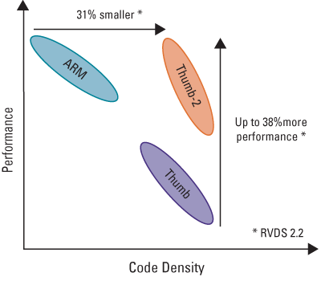
Code Density vs. Performance

Slide 25
The ARMv7-M “Cortex-M3” Architecture

Slide 26
ARM Cortex-M3 CPU
Load-store architecture
A barrel shifter allows operand Rm to be shifted left or right any number of bit positions before being combined with operand Rn in the ALU, thus allowing calculations of the form Rn +/- 2kRm.
A MAC (Memory Address Calculator) prepares subscripted and relative address references for memory access, and a special incrementer can adjust the memory address on subsequent instructions without having to recalculate the address.
Data Bus
Sign Extender
R15 (pc)
Registers
R0 – R15
Rd
Rn
Rm
Barrel Shifter
MAC
ALU
Result Bus
Address Register
Incrementer
Address Bus

Slide 27
Pipelined Instruction Execution
1st Instruction (Adrs: PC)
Fetch
16-bit Instruction fetched from memory
PC
Fetch
Decode
Execute
2nd Instruction (Adrs: PC+2)
Decode
Decompress thumb instruction, Decode ARM instruction Select registers
Fetch
Decode
Execute
PC - 2
3rd Instruction (Adrs: PC+4)
Execute
Read register(s) from Register Bank,
Shift and ALU operation,
Write register(s) back to Register Bank
Fetch
Decode
Execute
PC - 4
Time
Pipelining allows three instructions to be in progress simultaneously during any one processor clock cycle. While one instruction is fetched, another is decoded, and a third is executed. Thumb instructions are 16 or 32 bits wide, with the majority being 16 bits. Thus, while the address held in PC is being used to read one 16-bit instruction from memory, the previous instruction (from address PC-2) is decoded, and the one before that (from address PC-4) is executed. One instruction completed every cycle.

Slide 28
Non-Pipelined Instruction Execution (hypothetical)
1st Instruction (Adrs: PC)
Fetch
Decode
Execute
2nd Instruction (Adrs: PC+2)
Fetch
Decode
Execute
3rd Instruction (Adrs: PC+4)
Fetch
Decode
Execute
Time
One instruction completed every 3 cycles. Performance is much lower than pipelined execution.

Slide 29
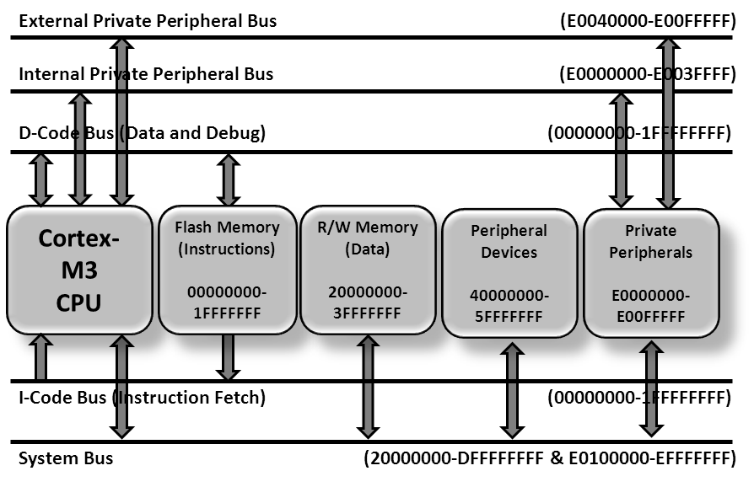
ARM Cortex-M3 Bus Structure (Harvard arch.)
Code and data are stored in separate and independent hardware; instructions are fetched over the I-Code bus from a nonvolatile flash memory while the system bus is used to access data in static read/write memory (or peripherals). Since the two memories are physically separate, overall performance is enhanced by a Harvard –style architecture with separate data paths that allow simultaneous instruction and data access

Slide 30
Summary
von Neumann vs. Harvard architectures
Instruction fetch/execute cycle
Instruction sets for ARM processors
ARM, Thumb, Thumb-2
Pipelined Instruction Execution

